Slide 1
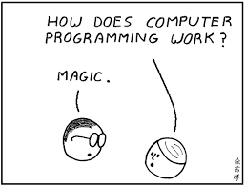

Slide 2
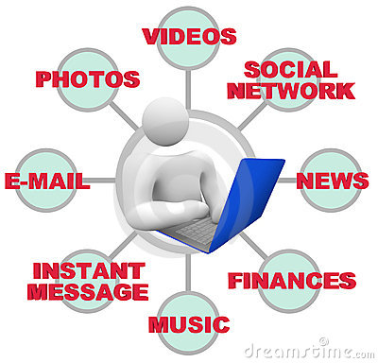
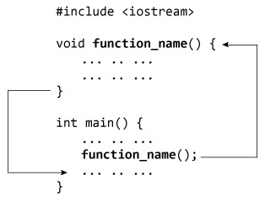
Behind Every Application…. There Is Program

Slide 3

Program means…..
Schedule
Plan
Organize
Arrange
If you want some one to work for you have to….provide instructions and object.

Slide 4

What Is Program????
An organized list of instructions that, when executed causes the computer to behave/operate in a predetermined manner.
computer is very dumb, but obedient. It does exactly what you tell it to do…

Slide 5

To give instructions you need language………
Will computer understand Human Language??????
If not
Then What????

Slide 6

Machine Language
(Popularly known as Binary language)
The only language understood by a computer is machine language

Slide 7

EACH LANGUAGE HAS ITS OWN CHARACTER SET
ENGLISH : 26 LETTERS
HINDI : 52 LETTERS
COMPUTER : 2 DIGITS (0,1)
Computer works with electricity.
If current is there it is represented by ‘1’ and if current is not there it is represented by ‘0’.

Slide 8
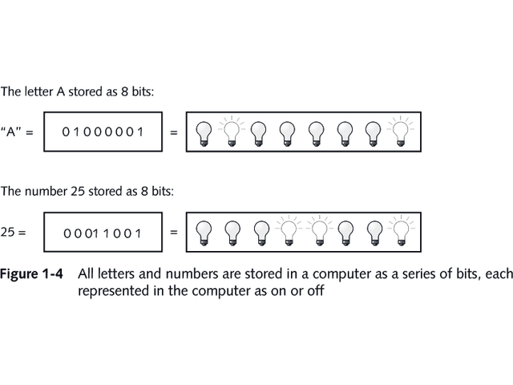

Slide 9


Writing program in Machine language is difficult
and time consuming !
“translator”

Slide 10
High level programming language
Is also called
User Friendly Language
as it uses English words and symbols
PROGRAM WRITTEN IN HIGH LEVEL LANGUAGE IS CALLED “SOURCE CODE”

Slide 11
ROLE OF LANGUAGE TRANSLATOR
SOURCE CODE
OBJECT CODE
0010101010101010111111111100000000000000000000001110101010101000000111111101001010
Language Translator
gives result
User Friendly
COMPUTER
Translator is also a program
Eventually every program must be translated into machine language program (OBJECT CODE)

Slide 12
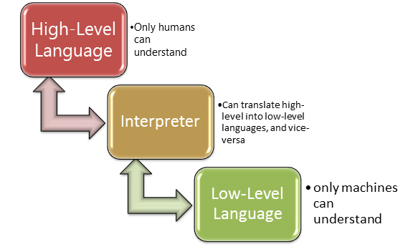

Slide 13
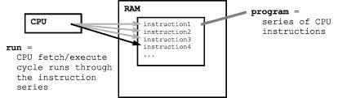
Instructions 1
Instructions 1
Instructions 1
Instructions 1
Instructions 1
Instructions 1
Instructions 1
series of CPU
instructions
Run =
CPU fetch/execute
cycle runs through
the instruction
series

Slide 14
Some High level
Programming languages
QBasic
C++
Cobol
Java
Pascal
And many more……..

